Slide 1





Patient and public involvement and engagement
Dr Charlotte Sharp & Dr Jane Taylor

Slide 2

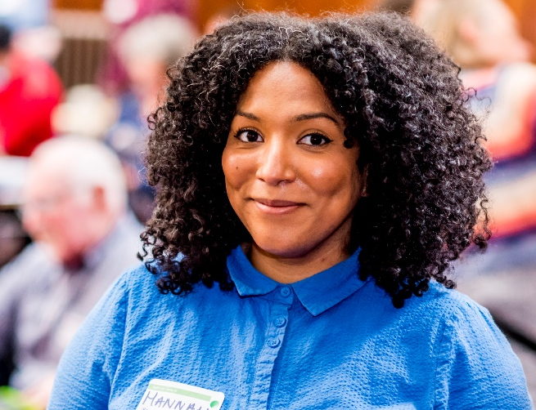

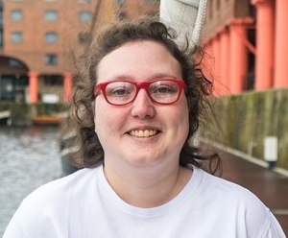


Our team
Lynn Laidlaw
Hannah
Turner-Uaandja
Jane Taylor
Leila Hamrag
Notes:
Lynn and Charlotte – joint PPIE leads, shared responsibility, Lynn with strategic input across HrFH, chairing and presenting webinars, contributing to specific project PPIE.
Leila and Jane as public contributors providing their extensive expertise for this grant writing retreat
Hannah and VOCAL – providing PPIE expertise, collaborating for their expertise and PPIE networks (important! – very hard to start completely from scratch as relationships and trust are so vital), and facilitation

Slide 3
Our aim from this grant writing retreat
That you understand…
the value and importance of patient and public involvement and engagement
the different ways in which you can involve patients and the public
how and why PPIE should be properly budgeted for
what reviewers are looking for from the PPIE section of a bid
why it’s really fun and rewarding, and will make your research much more powerful and impactful

Slide 4
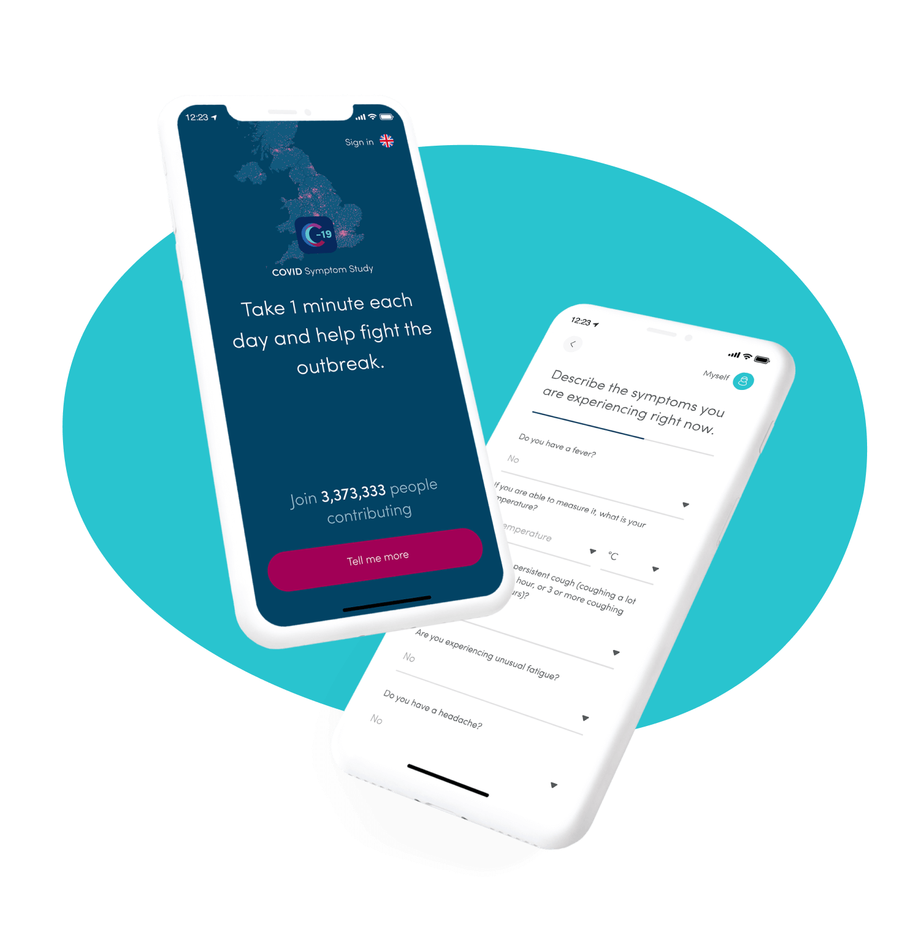
Overview - COVID Symptom Study App
Mobile health project – smartphone app
Benefitted from huge national interest in understanding the disease
Daily logging of symptoms across the pandemic
Report of test results
Required an active pool of loggers
Fine balance to ensure engagement of participants
Continuous development improvement and dissemination
Notes:
I’m going to use this case study to demonstrate the value and importance of PPIE, and how powerful it can be, within the context of smartphone research
Acknowledge Claire Steves

Slide 5
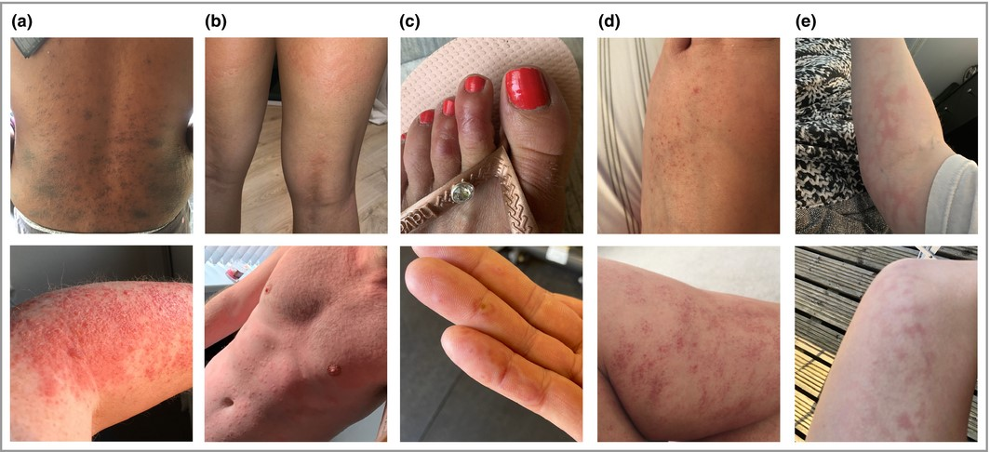
Community science: How the community drove insights
Participants reported skin rashes and helped develop new questions on the app
Catalogue of pictures of rashes

Slide 6
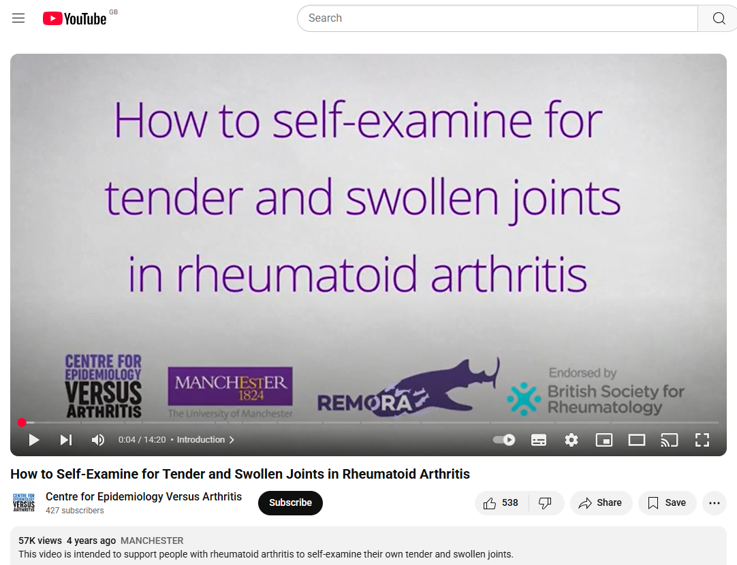
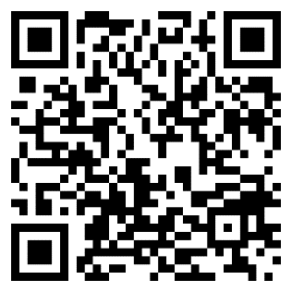
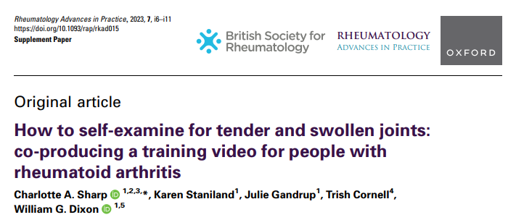
tinyurl.com/REMORAvideo

Slide 7
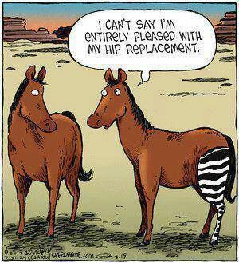
It’s important to know what matters to the patient. It may be different from what matters to the researchers or the clinician!

Slide 8
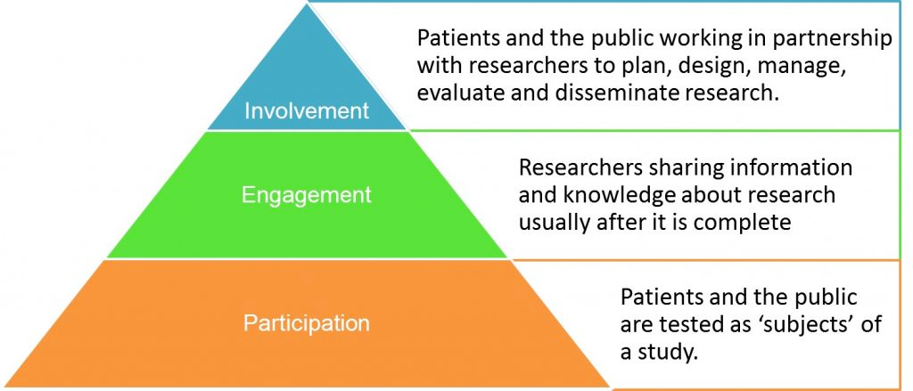
What is involvement?

Slide 9
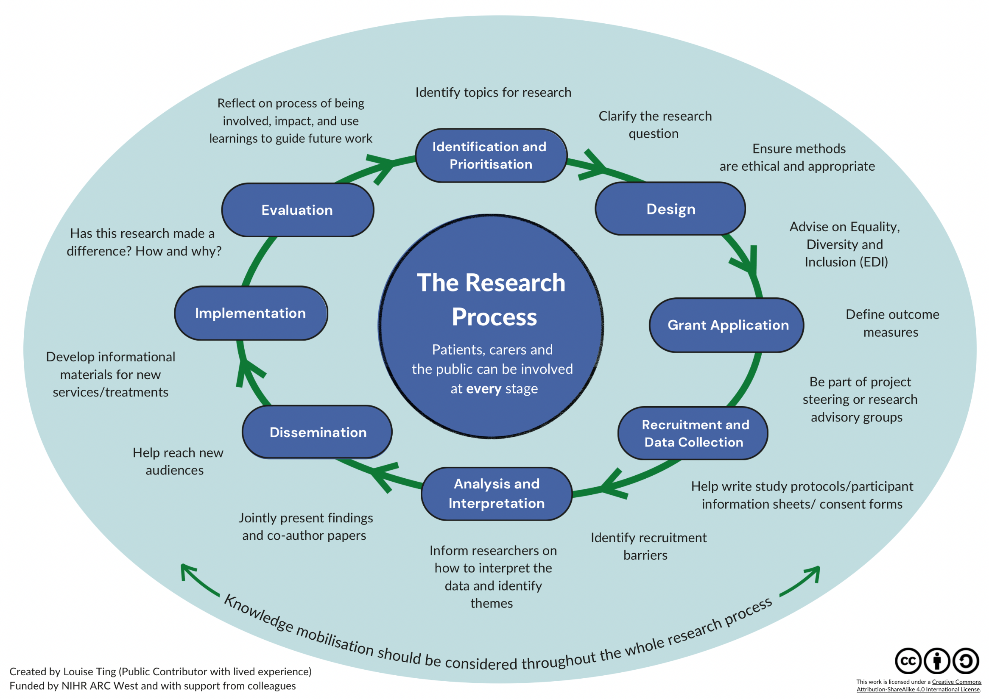

Slide 10

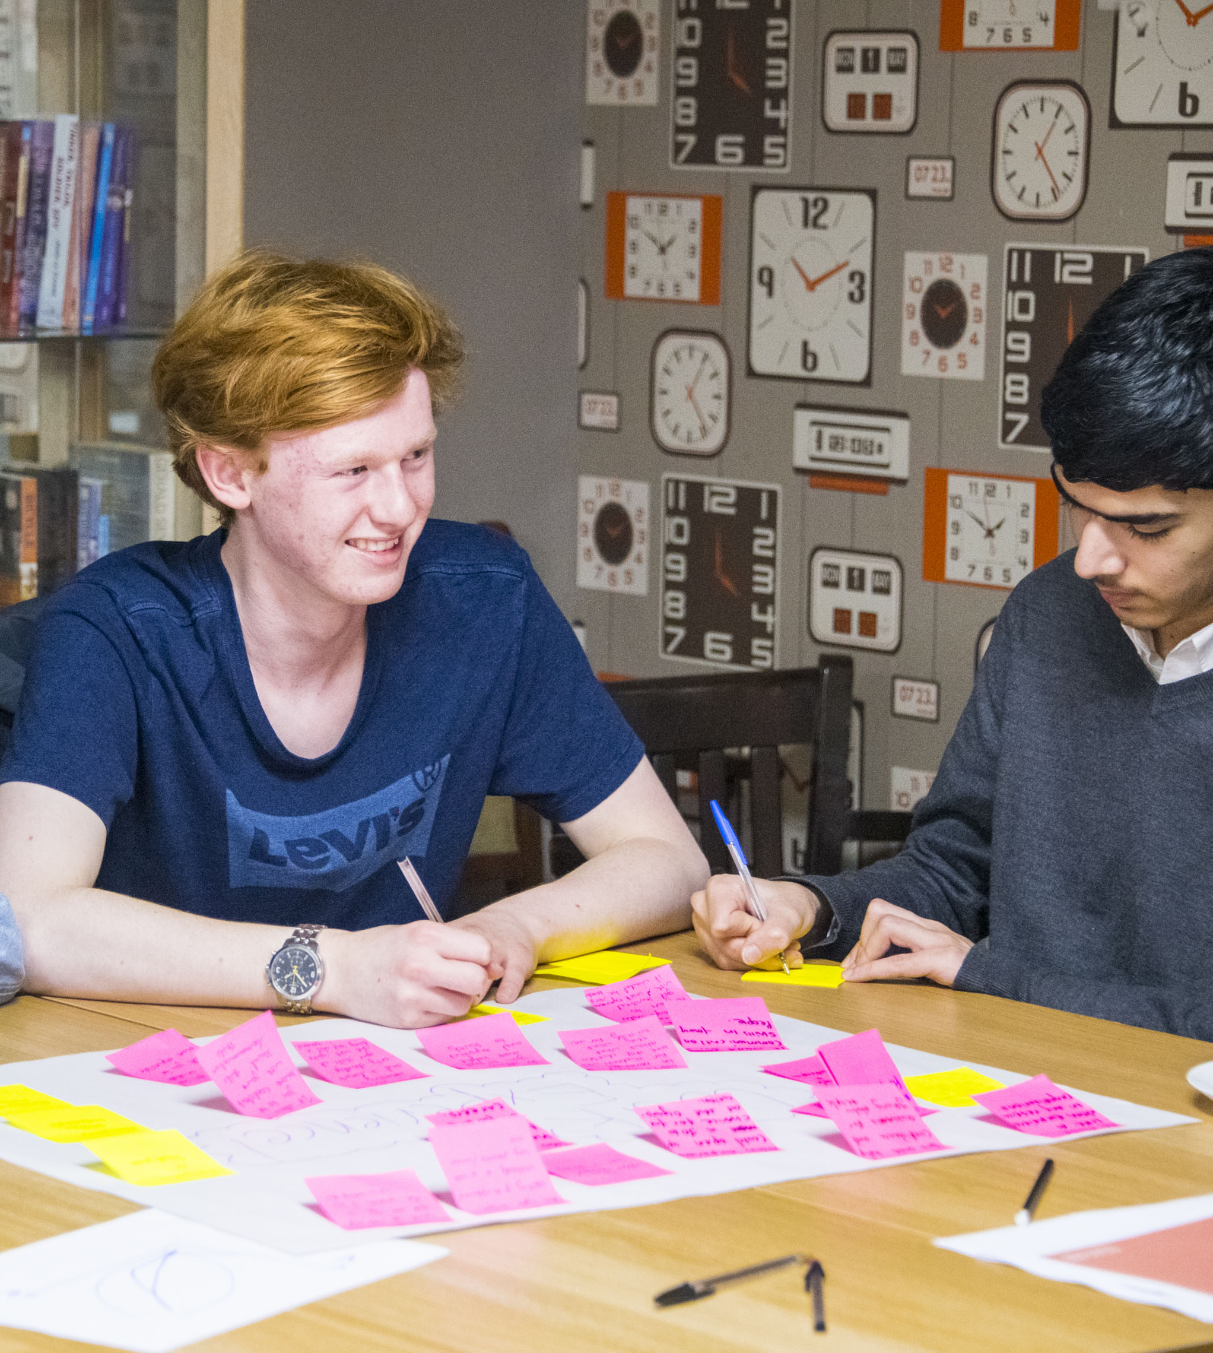


Start early
Think about PPI as soon as you start thinking about your research
Involve patients/carers in shaping and reviewing bid/proposal
Think about funding – allocation of and sources of funding.
Think about how you might plan involvement across the research cycle.
Notes:
Funders looking out for well thought through PPI
Vocal door always open – drop ins etc
Survey response - To understand the landscape of PPI opportunities in Manchester, to help direct researchers to the most appropriate options

Slide 11
Thinking about Funding
Before you are awarded funding…
Use existing formal groups, e.g. PRIMER at UoM, VOCAL
Ask colleagues about patients working on related projects – can you owe them a favour?
Contact charities, local patient groups etc.
People in Research online (for researchers looking for members of public to get involved in research)
Use social media
Apply for small pots / pump prime / seedcorn funding
When you apply for funding…
Make sure this is properly budgeted for!
Awarding committees look closely at your funding estimates. Don’t underestimate your PPI costs.

Slide 12
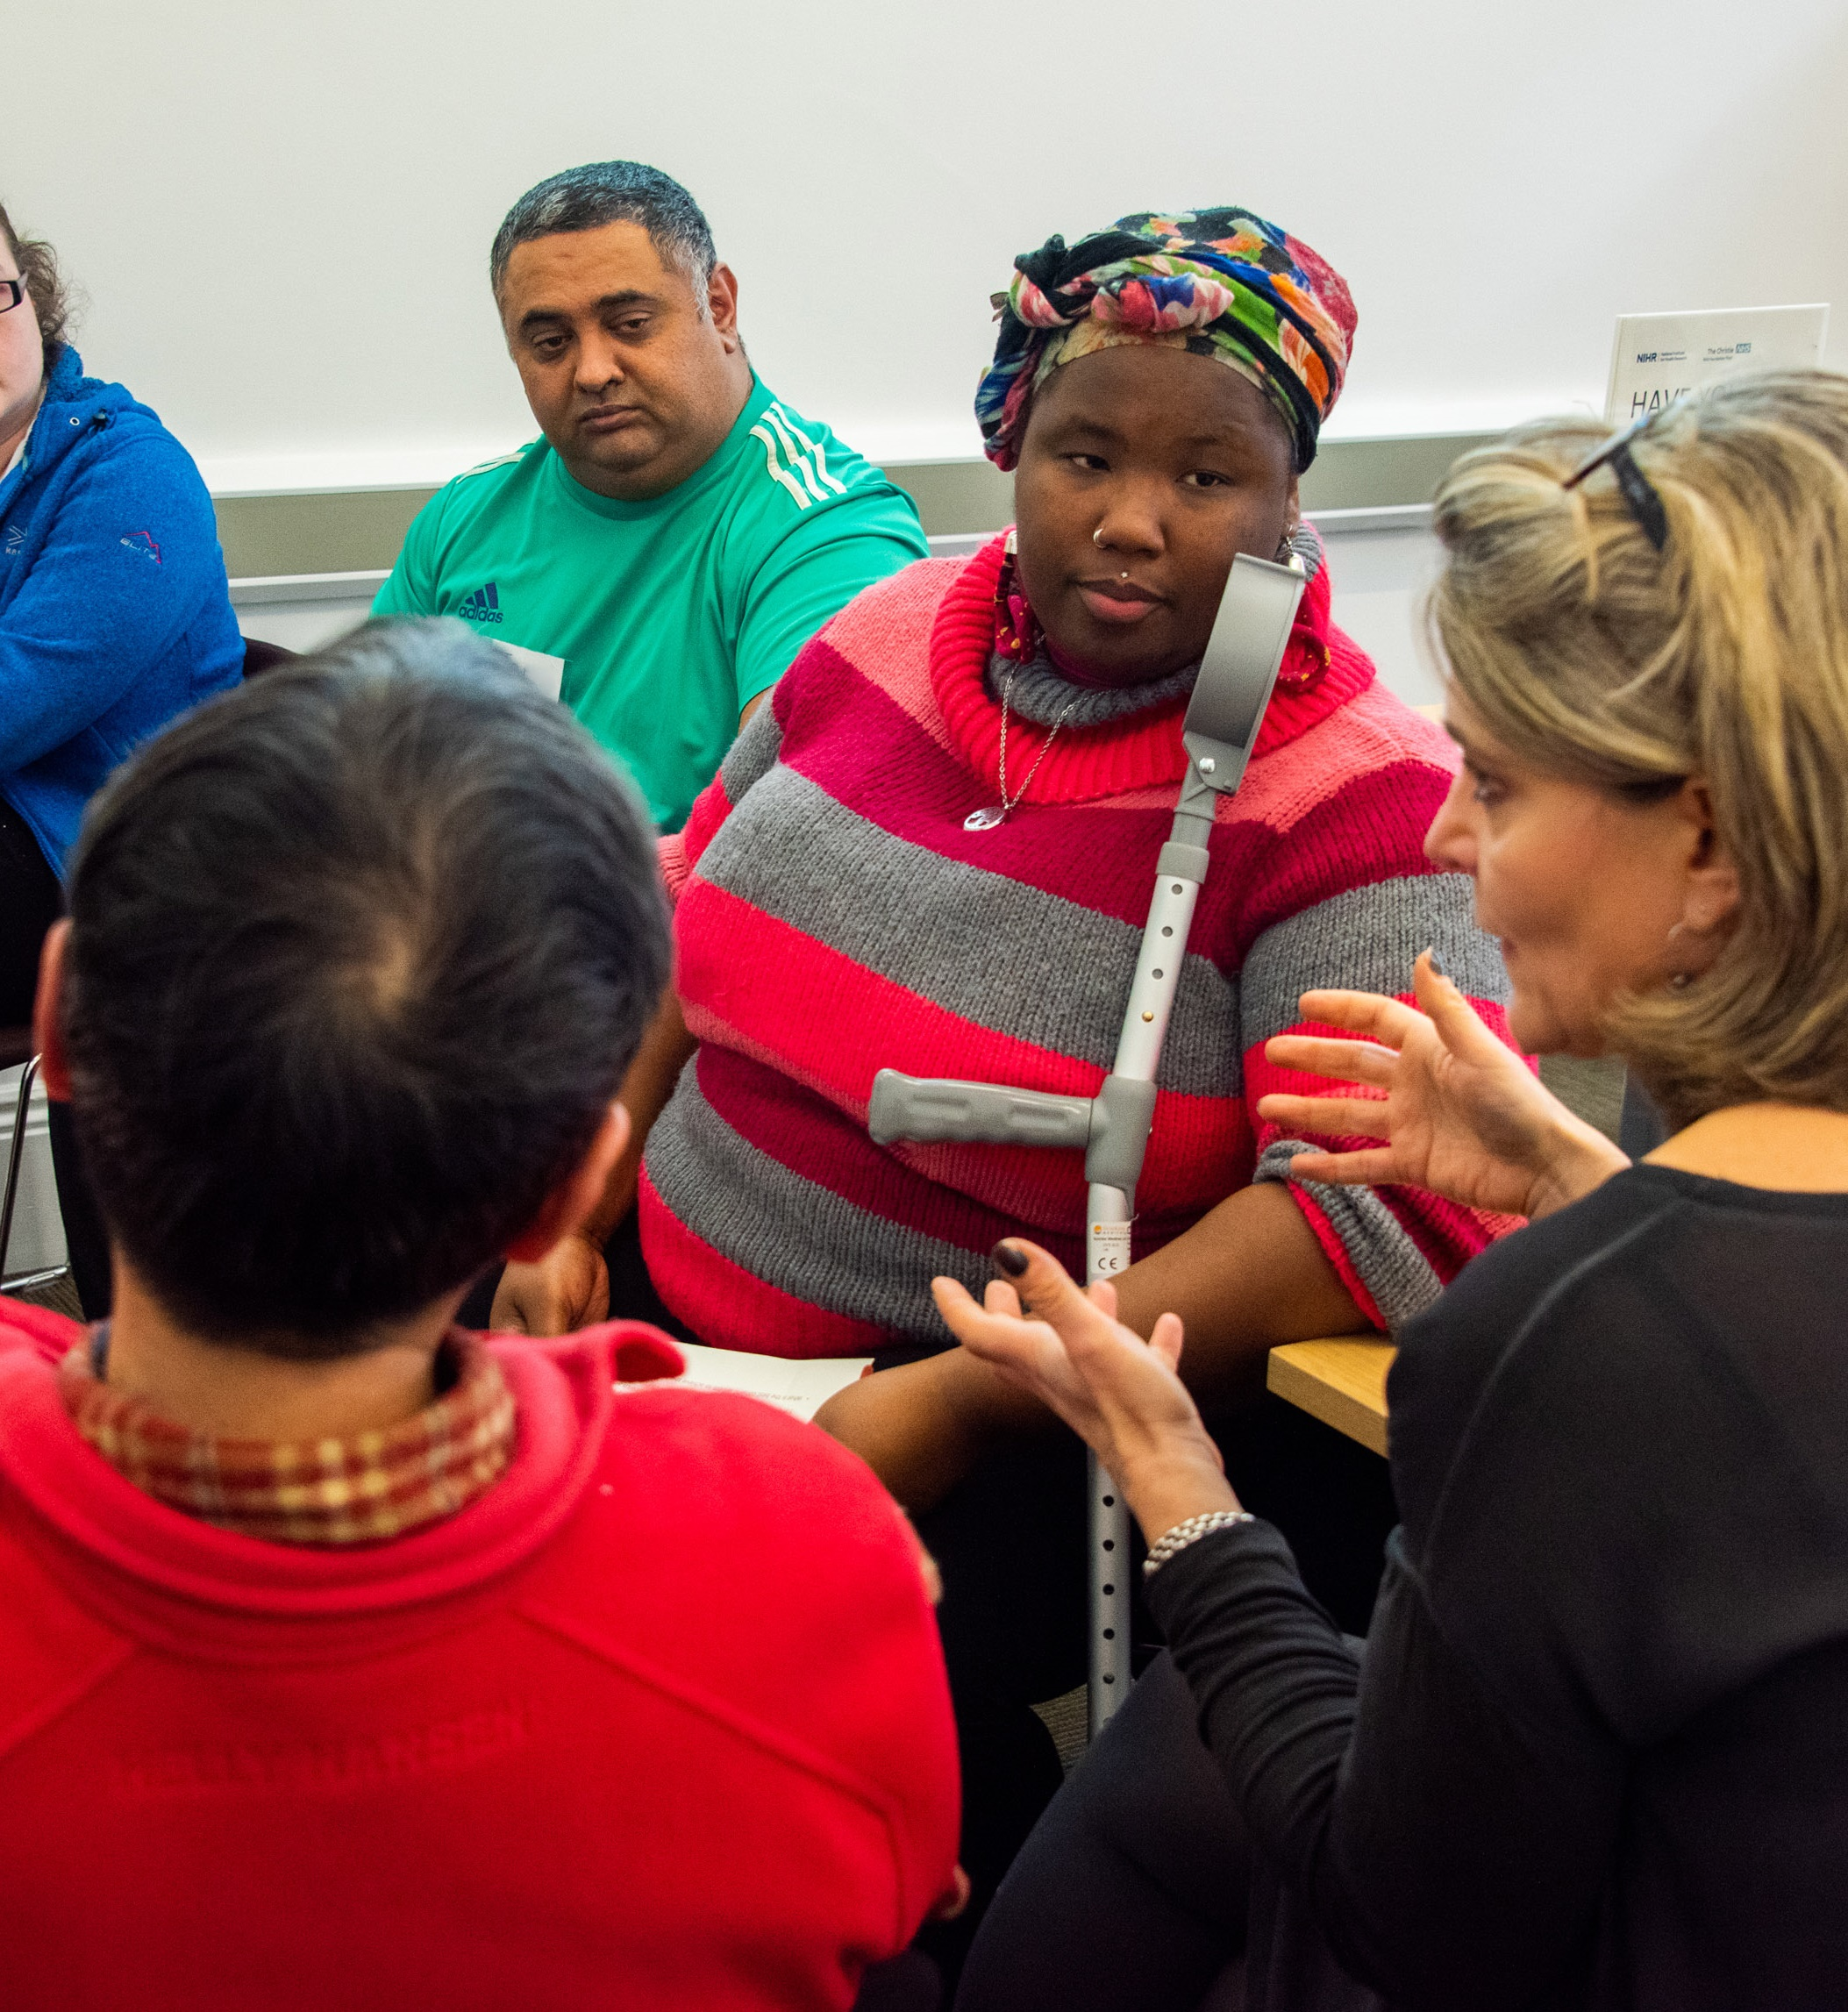


What to budget for?
Payment and expenses
Payments to individuals
Fees for partners
Funding for public contributor training
Travel
Subsistence
Conference fees
Staff time
Access and inclusion
Remote / home working costs
Childcare
Language translation
BSL interpretation and communication aids (e.g. text to speech technology, hearing loop hire)
Carer or assistant costs
Delivery costs
Recruitment costs (e.g. advertising, working with specific groups etc)
Venue hire and catering
Equipment costs
Notes:
@Jane – we will talk through budgets for specific PPIE engagements during the ‘ppie clinic activity’, so not much detail needed here

Slide 13
Checklist: What are the aims of your research?
Who should you involve?
How will you find them?
At what stages in your project?
What will they do at each stage? Be specific!
COST
IMPACT

Slide 14
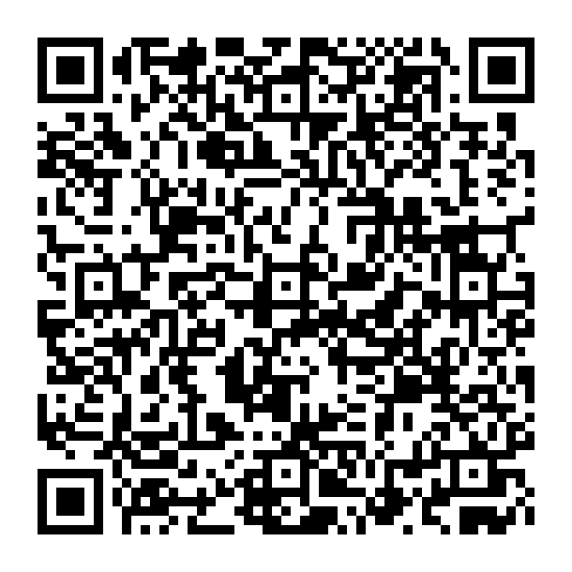
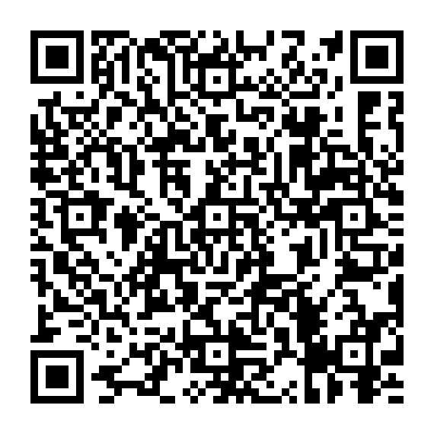
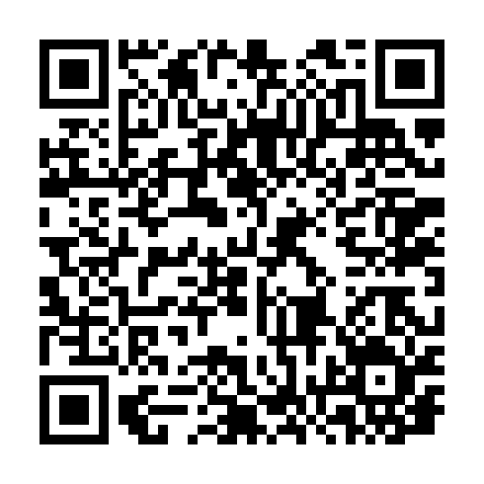
Resources
NIHR INVOLVE https://www.nihr.ac.uk/research-funding
/application-support/working-with-people-and-communities
NIHR Research Support Service https://www.nihr.ac.uk/support-and-services/research- support-service
Research involvement and engagement https://researchinvolvement.biomedcentral.com/

